Slide 1
Announcements
Homework: please start early
Please do not copy from anywhere and work on your code yourself. Our detection agents are super smart!
Please don’t post any material from this class, including your homework and related materials, to any public places, such as GitHub or others, on the Internet !
(Note: GitHub private repositories are OK)

Slide 2
Analysis of Large Graphs: Overlapping Communities
Professor Wei-Min Shen
University of Southern California
Thanks for source slides and material to:
J. Leskovec, A. Rajaraman, J. Ullman: Mining of Massive Datasets
http://www.mmds.org
Note to other teachers and users of these slides: We would be delighted if you found this our material useful in giving your own lectures. Feel free to use these slides verbatim, or to modify them to fit your own needs. If you make use of a significant portion of these slides in your own lecture, please include this message, or a link to our web site: http://www.mmds.org

Slide 3
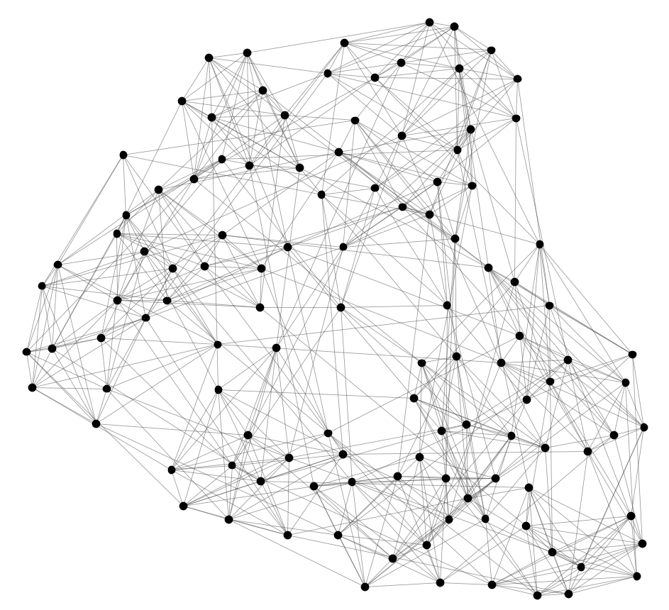
Identifying Communities
Can we identify node groups?
(communities, modules, clusters)
Nodes: Football Teams
Edges: Games played

Slide 4
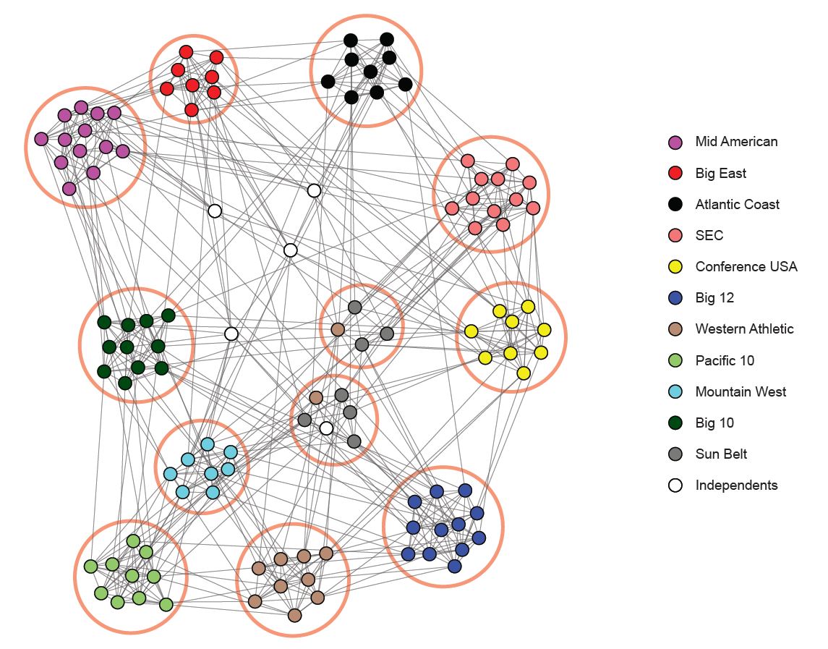
NCAA Football Network
NCAA conferences
Nodes: Football Teams
Edges: Games played

Slide 5
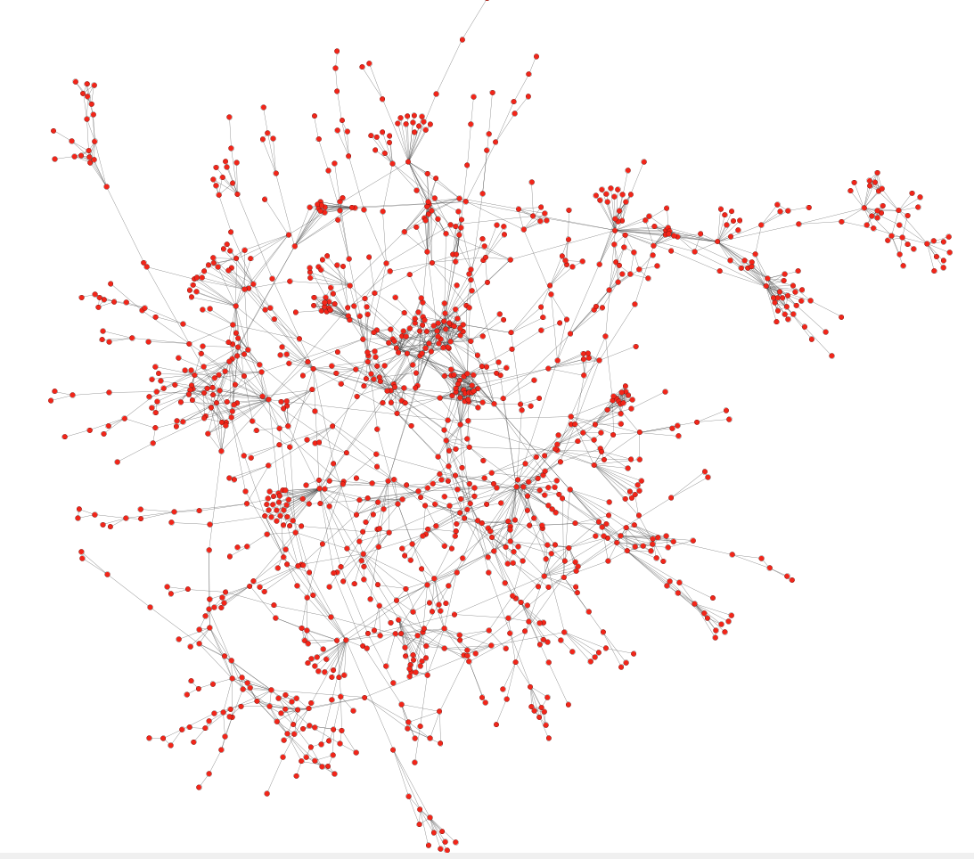
Protein-Protein Interactions
Can we identify functional modules?
Nodes: Proteins
Edges: Physical interactions

Slide 6
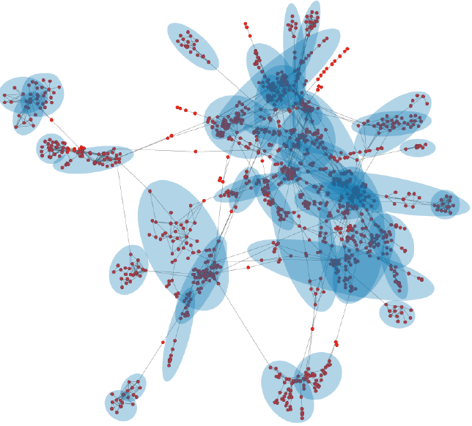
Protein-Protein Interactions
Functional modules
Nodes: Proteins
Edges: Physical interactions

Slide 7
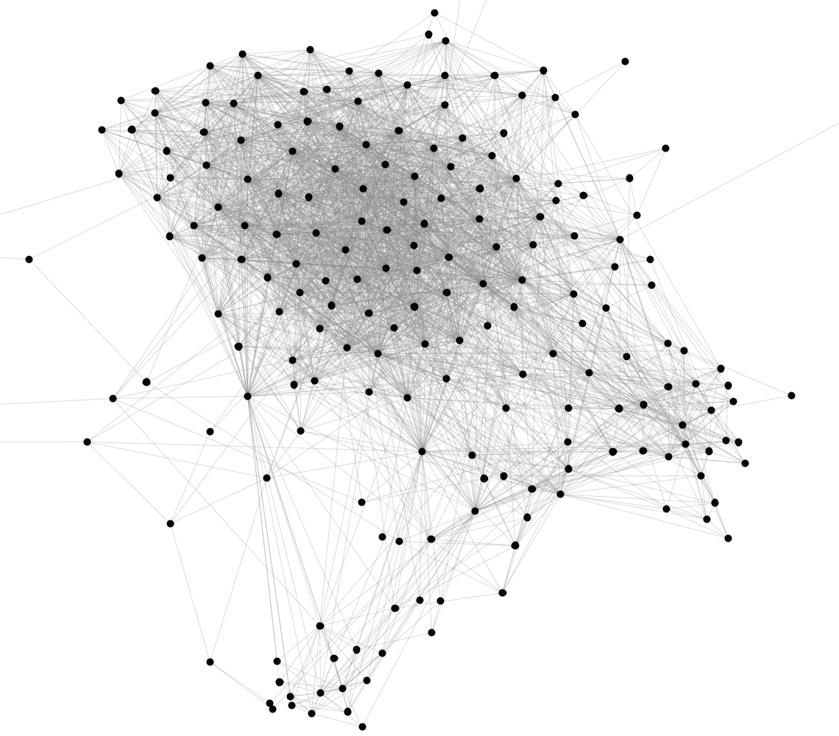
Facebook Network
Can we identify social communities?
Nodes: Facebook Users
Edges: Friendships

Slide 8
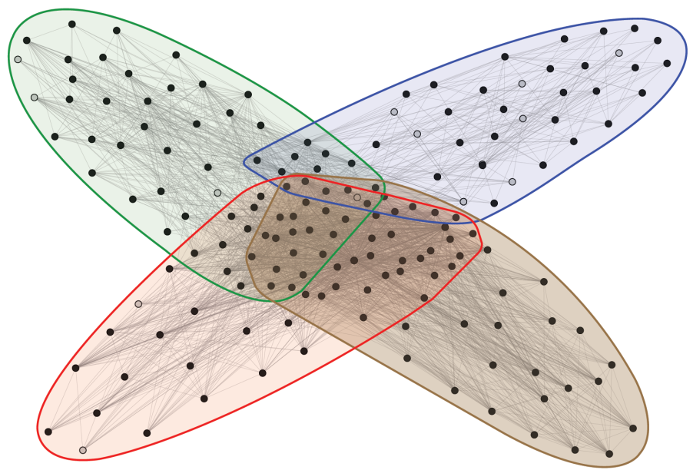
Facebook Network
Social communities
High school
Summer internship
Stanford (Basketball)
Stanford (Squash)
Nodes: Facebook Users
Edges: Friendships

Slide 9
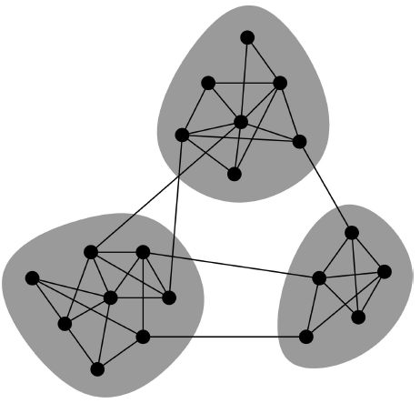
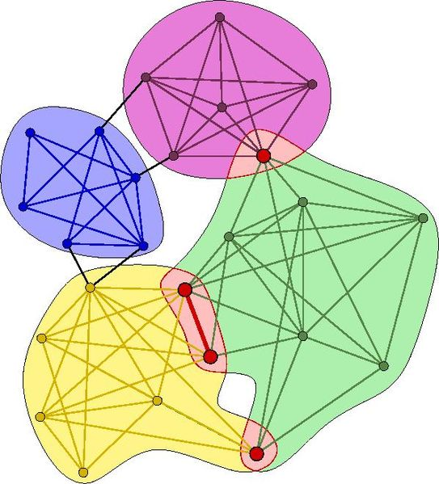
Overlapping Communities
Non-overlapping vs. overlapping communities

Slide 10
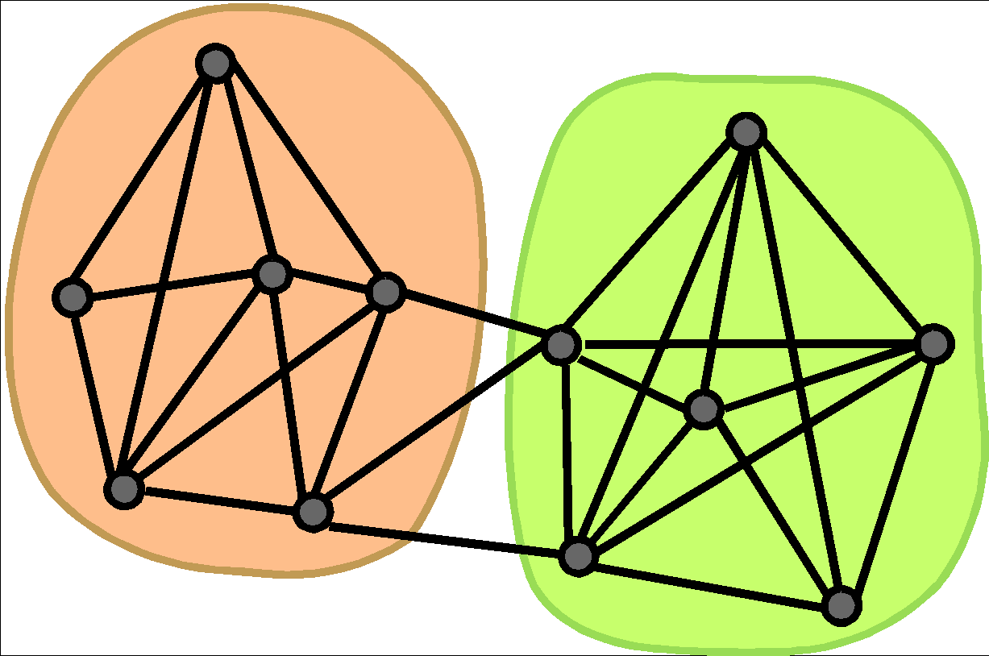
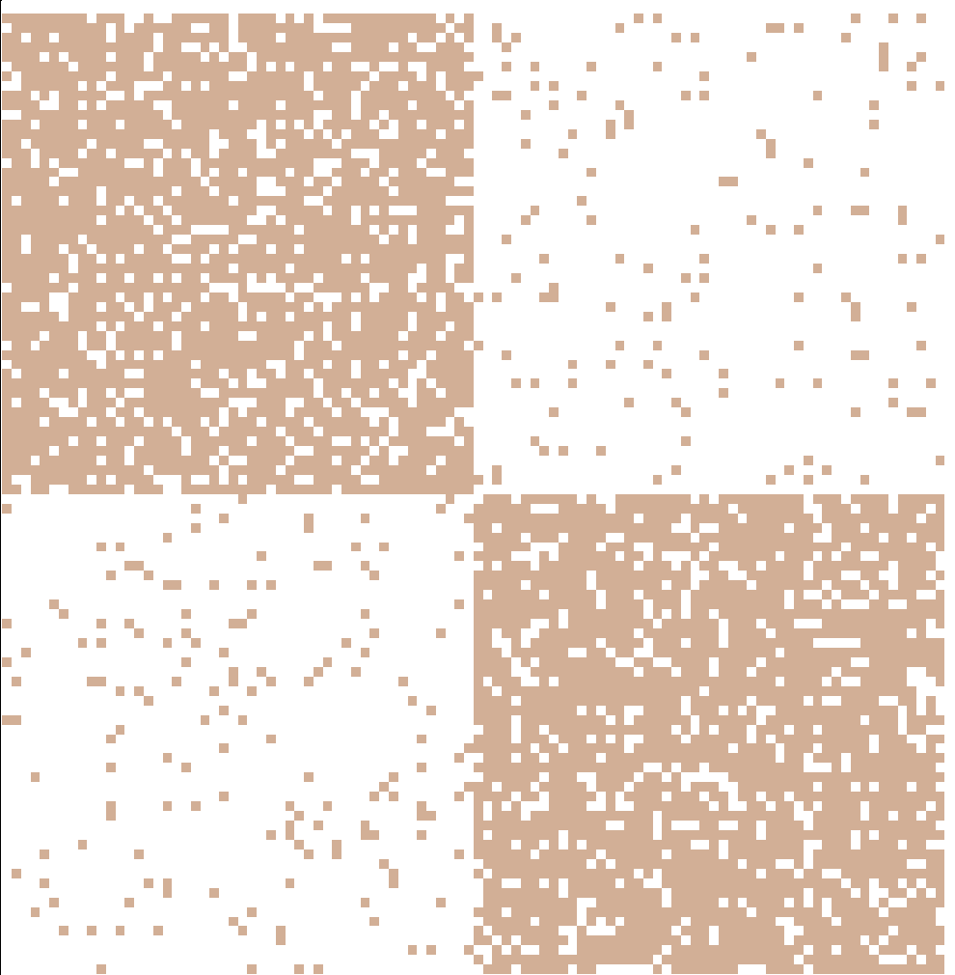
Non-overlapping Communities
Nodes
Nodes
Network
Adjacency matrix

Slide 11
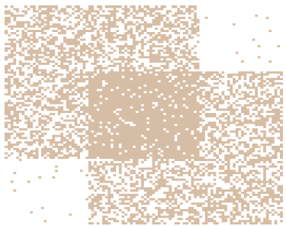
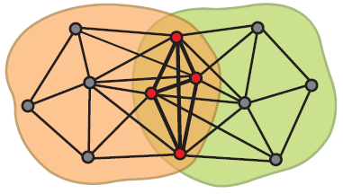
Communities as Tiles!
What is the structure of community overlaps: Edge density in the overlaps is higher!
Communities as “tiles”

Slide 12

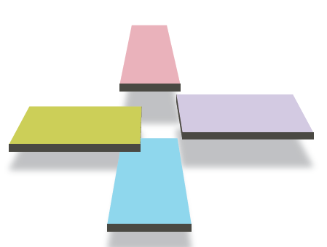
Recap so far…
Communities in a network
This is what we want!

Slide 13
Plan of attack
1) Given a model, we generate the network:
2) Given a network, find the “best” model
Generative model for networks
B
A
F
D
E
C
G
H
Generative model for networks
B
A
F
D
E
C
G
H

Slide 14
Model of networks
Goal: Define a model that can generate networks
The model will have a set of “parameters” that we will later want to estimate (and detect communities)
Q: Given a set of nodes, how do communities “generate” edges of the network?
Generative model for networks
B
A
F
D
E
C
G
H
Notes:
Occupation
Sex
Items
Race

Slide 15
Maximum-Likelihood Estimation

Slide 16
Maximum-Likelihood Estimation
Assume a generative process (the model M )
for creating instances of some artifact, for example, “friends graphs” G₁ ,…,G₂₅ ,..
The model has parameters
for determining the probability of generating any particular instance of the artifact
the “likelihood” of the parameter values
The value of the parameters that gives the largest value of the likelihood is the “correct” model for the observed artifact
P(G₅|M) = ?
What is the simplest model for a graph?
How many parameters does it have?

Slide 17
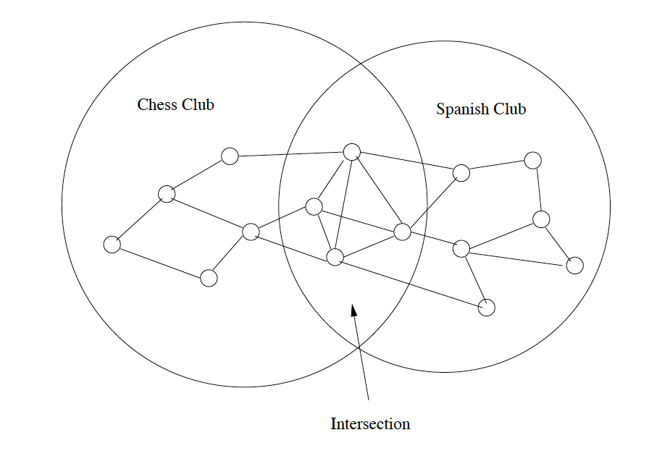
Simple MLE Example (1)
Model: Each edge is present with probability p with the presence or absence of each edge chosen independently
Parameter: p // this model M has only one parameter
Example: a graph with 15 nodes and 23 edges
How many pairs of nodes do we have in total? C₁₅² = 105
If each edge is connected by a probability p, the probability of having the graph on the right is P(G_{x}|M) = p²³(1-p)⁸²
Gx
Notes:
C15 C2 =

Slide 18
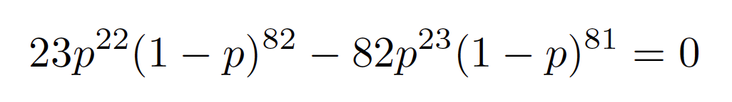
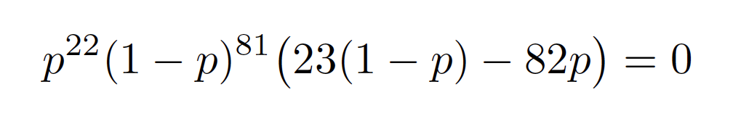
Simple MLE Example (2)
NOW, the other way around
Given this graph, what is the best value for p ?
Take the first derivative of the probability function p²³(1-p)⁸² and set it to 0 for finding the maximum/minimum of p, as follows
Maximum or minimum of p²³(1-p)⁸² happens when
Either p=0 or 1 or 23(1-p)-82p = 0
The likelihood of generating the graph in the previous slide is maximized when 23(1-p)-82p = 0
That is: p = 23/105, therefore,
P(G_{x}|M) = p²³(1-p)⁸²=(23/105)^23 * (1-23/105)^82 = 1.0656135e-24
Notes:
morning

Slide 19
MLE Approach
Given a graph G
Write up a probability function f(p) of G
To find the best p for f(p):
Set the derivative of f(p) to be 0: f ‘(p) = 0
Solve the equation f ‘(p)=0 to get p
The result p will be the “best” model for G

Slide 20
Affiliation-Graph Model

Slide 21


Community-Affiliation Graph
Each community has a model!
Communities, C
p_{A}
p_{B}
Memberships, M
Nodes, V
Model
Network
Generative model B(V, C, M, {p_{c}}) for graphs:
Nodes V, Communities C, Memberships M
Each community c has a model which is a probability p_{c}
Later we fit the model to networks to detect communities

Slide 22
Affiliation-Graph Model (AGM)
The Community-Affiliation Graph
Given
A number of communities, and
A number of individuals (nodes)
Two sets of parameters
The membership parameters
Each community can have any set of individuals as members (binary memberships)
A probability Pc for each community C
The probability that two members of a community C are connected because they are both members of C
Node: If a pair of nodes is in two or more communities, then there is an edge
between them if any of the communities of which both are members justifies
that edge according to rule 3 (see the next slide for an example)

Slide 23
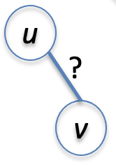
Should u and v have an edge?
Two communities C and D
Node u and v are in a single community
What is the probability of (u, v) exists: P_{C}
C
u
?
D
v

Slide 24
Should u and v have an edge?
Two communities C and D
Node u and v are in two different communities
What is the probability of (u, v) exists: ?
v
C
u
u
?
D
v

Slide 25
Should u and v have an edge?
Two communities C and D
Node u and v are in two different communities
What is the probability of (u, v) exists: ? // as small as possible
v
C
u
u
?
D
v

Slide 26
Should u and v have an edge?
Two communities C and D
Node u and v are in as follows
What is the probability of (u, v) exists: ?
C
u
v
u
?
D
v

Slide 27
Should u and v have an edge?
Two communities C and D
Node u and v are in both communities
What is the probability of no edge between u, v: (1 - P_{C})(1 - P_{D})
What is the probability of (u, v) exists: 1 - (1 - P_{C})(1 - P_{D})
C
u
?
D
v

Slide 28
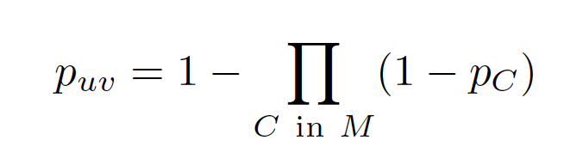
AGM: Generative Process (1)
Nodes: u, v; Edge: (u, v)
u and v are in both communities C and D but not in other communities
Given the probability that two nodes in C (or D) are connected is P_{C} (or P_{D})
The probability of no edge between u, v is (1 - P_{C})(1 - P_{D})
The probability of (u, v) exists is 1 - (1 - P_{C})(1 - P_{D})
General case: If u and v are members of a set M of communities, the probability of an edge between u and v is:
Notes:
evening

Slide 29
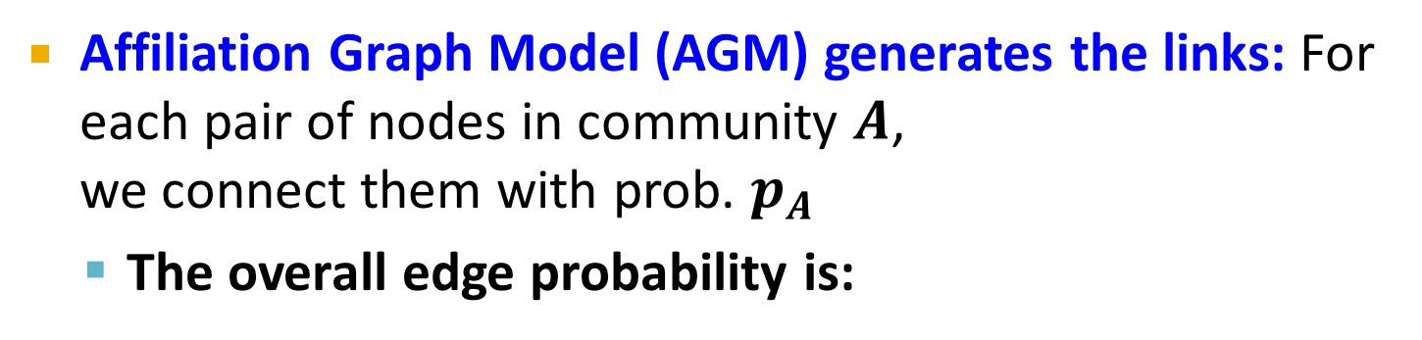
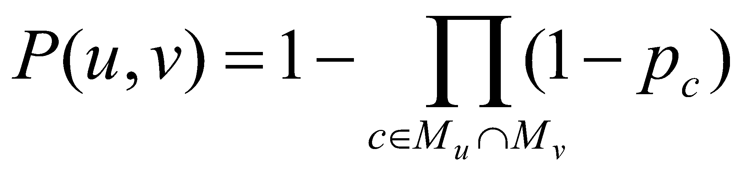
AGM: Generative Process (2)
p_{A}
p_{B}
Communities, C
Memberships, M
Nodes, V
Community Affiliations
Network
Affiliation Graph Model (AGM) Generates the links:
For each pair of nodes u and v in community C, we connect them with probability p_{c,} then the overall edge probability is:
where M_{u} is the set of community u belongs to
If u and v share no community, then we let P(u,v) = ε, where ε is very tiny number // very unlikely to have such an edge
Think of this as an “OR” function: If at least 1 community says “YES” we create an edge
Notes:
Epsilon

Slide 30
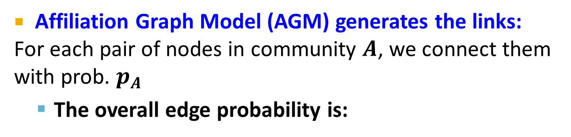
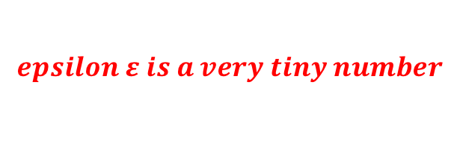
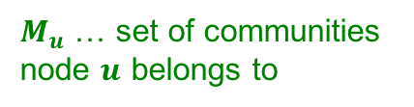
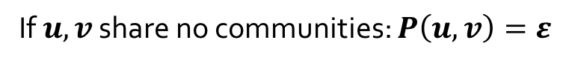
AGM: Generative Process (2)
Communities, C
p_{A}
p_{B}
Memberships, M
Nodes, V
Community Affiliations
Network
between any u and v:
Think of this as an “OR” function: If at least 1 community says “YES” we create an edge
Notes:
Epsilon

Slide 31
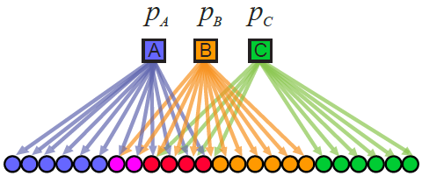
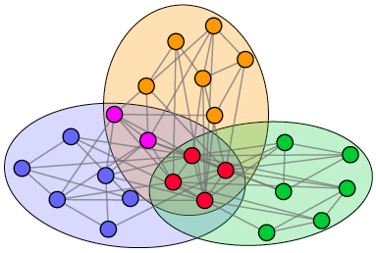
Recap: AGM networks
Model
Network

Slide 32
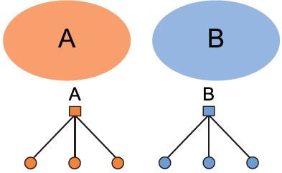
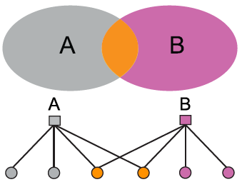
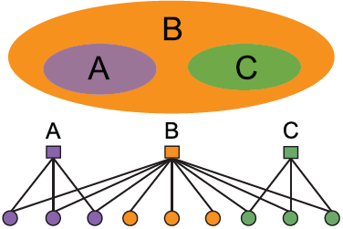
AGM: Flexibility
AGM can express a variety of community structures: Non-overlapping, Overlapping, Nested

Slide 33
HOW DO WE DETECT COMMUNITIES WITH AGM?

Slide 34
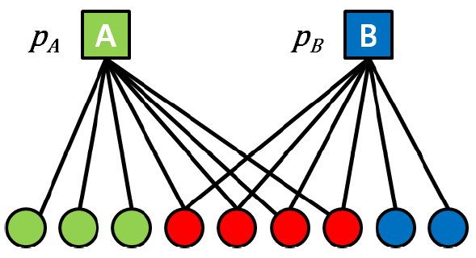
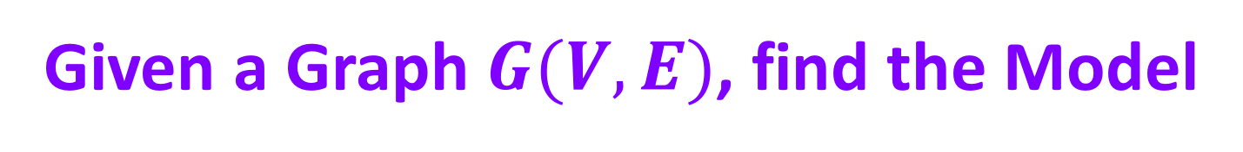
Detecting Communities
Detecting communities with AGM:
B
A
F
D
E
C
G
H
Affiliation graph M
Number of communities C
Parameters p_{c}

Slide 35
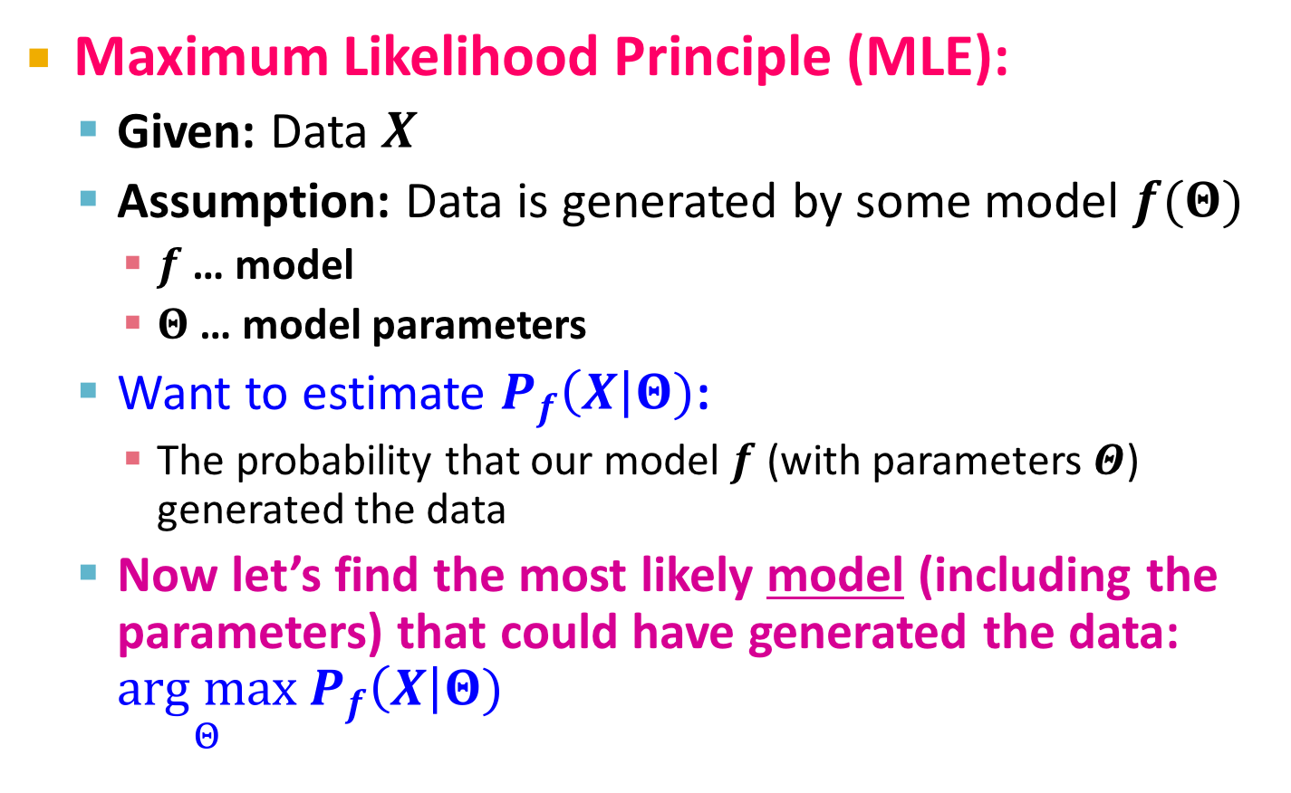
Maximum Likelihood Estimation
Notes:
the arguments of the maxima

Slide 36
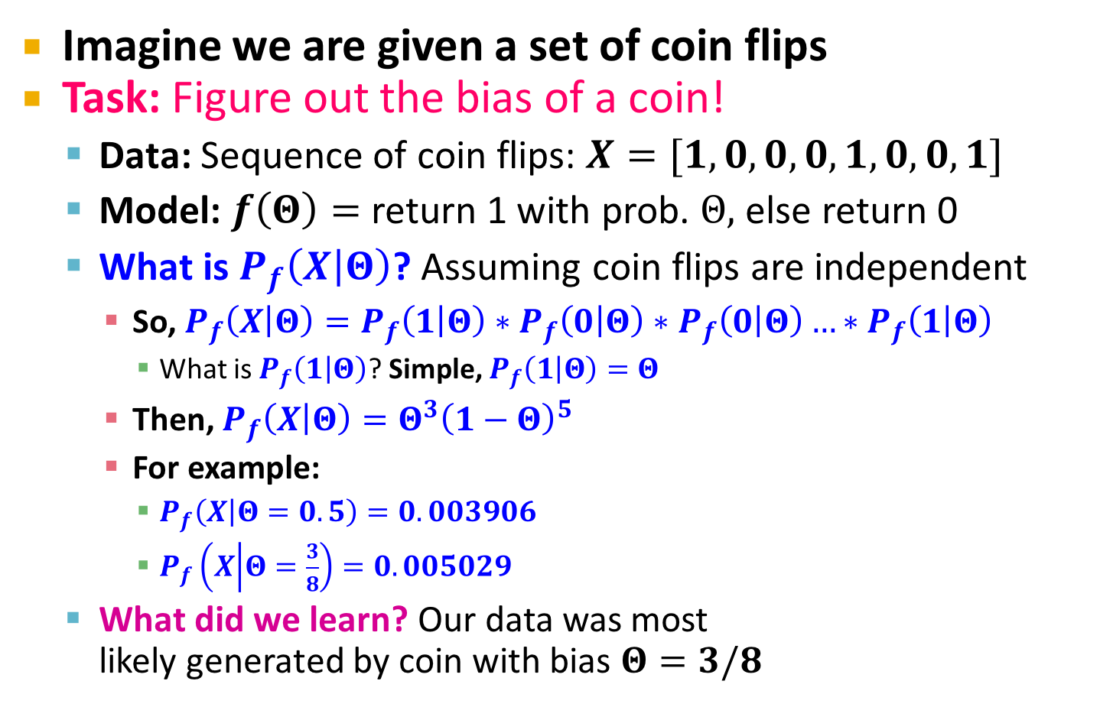
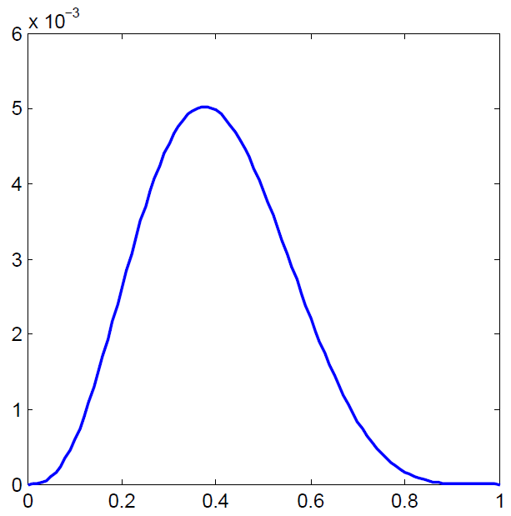
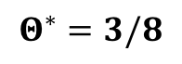
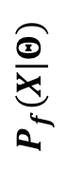

Example: MLE
Notes:
2018 Spring Week 2 1.1

Slide 37
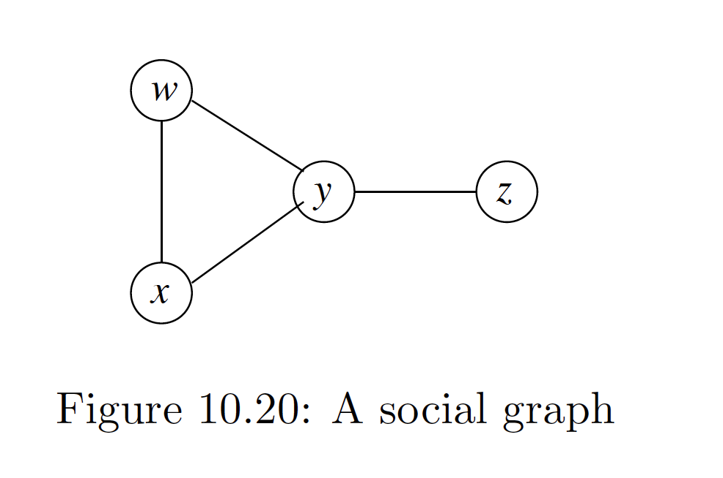
AGM Example (1)
Using AGM for modeling the graph below
Assumptions (preset some of the parameters):
There are two communities C and D with P_{C} and P_{D}
We have determined (or are using as a temporary hypothesis) the community memberships:
C = {w, x, y} and D = {w, y, z}

Slide 38
AGM Example (2)
Given C = {w, x, y} and D = {w, y, z}
For w and x, M_{wx} = {C}
P_{wx} = 1 – (1 - P_{c}) = P_{c}
And
P_{xy} = P_{C} and P_{yz} = P_{wz} = P_{D}
P_{wy}= 1 - (1 - P_{C})(1 - P_{D})
P_{xz} = a tiny value (very low probability)
The likelihood of this graph given the membership assumption
P(G|AGM) = P_{wx}P_{wy} P_{xy} P_{yz} (1-P_{wz})(1-P_{xz})
= (P_{C})²P_{D}(P_{C}+P_{D}-P_{C}P_{D})(1-P_{D})(1-ε)
C
D

Slide 39
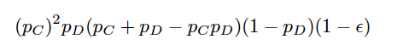
AGM Example (3)
Now, Find the values of P_{C} and P_{D} that maximize:
The last factor can be dropped because ε is negligible
You can solve it by setting its derivative = 0
Or
You can solve it by the following estimated reasoning
Let P_{C} should be as large as possible
Given P_{c} = 1, then the above expression becomes p_{D}(1-p_{D})
p_{D}(1-p_{D}) is maximal when P_{D}=0.5
Thus, the maximum likelihood for the graph in Fig. 10.20 occurs when
Members of C are certain to have an edge between them and
There is a 50% chance that joint membership in D will cause an edge between the members

Slide 40
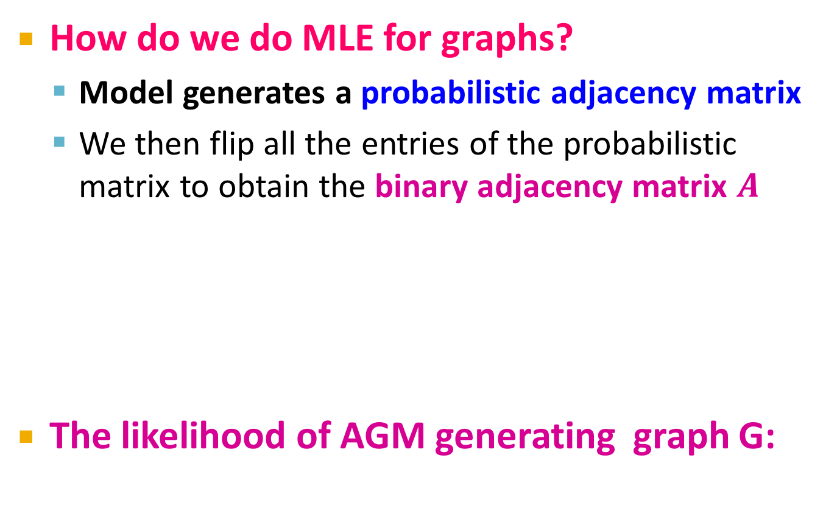

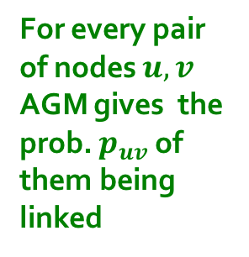
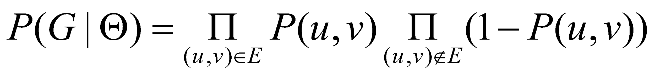
Maximum-Likelihood Estimation for Graphs
Flip biased coins
0 | 0.10 | 0.10 | 0.04
0.10 | 0 | 0.02 | 0.06
0.10 | 0.02 | 0 | 0.06
0.04 | 0.06 | 0.06 | 0
0 | 1 | 0 | 0
1 | 0 | 1 | 1
0 | 1 | 0 | 1
0 | 1 | 1 | 0

Slide 41
Graphs: Likelihood P(G|Θ)
Given graph G(V,E) and Θ, we calculate likelihood that Θ generated G: P(G|Θ)
G
0 | 0.9 | 0.9 | 0
0.9 | 0 | 0.9 | 0
0.9 | 0.9 | 0 | 0.9
0 | 0 | 0.9 | 0
0 | 1 | 1 | 0
1 | 0 | 1 | 0
1 | 1 | 0 | 1
0 | 0 | 1 | 0
A
B
Θ=B(V, C, M, {p_{c}})
G
P(G|Θ)

Slide 42
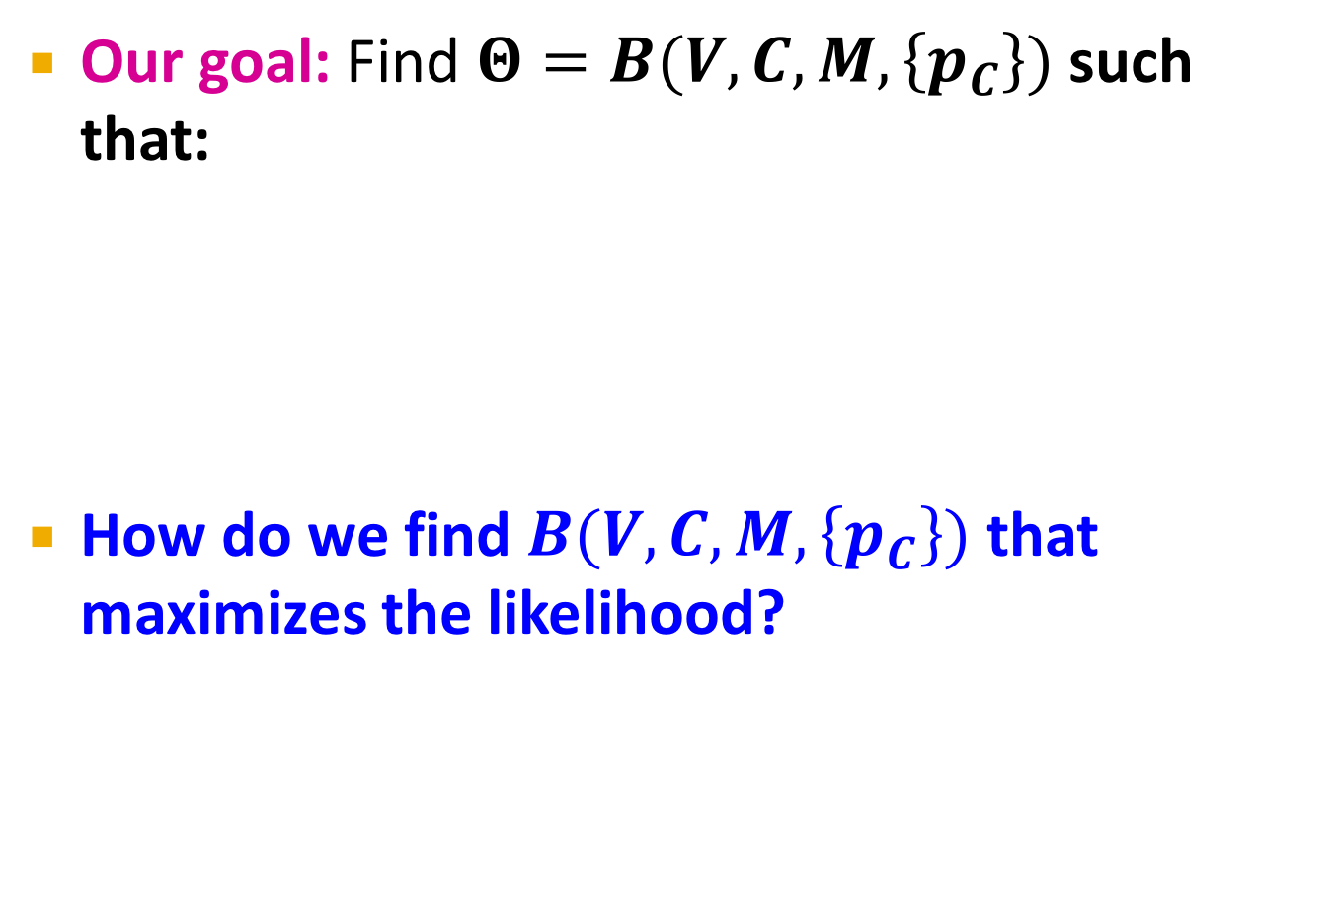
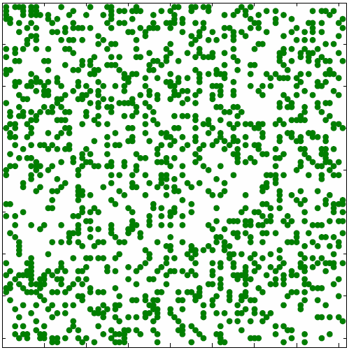
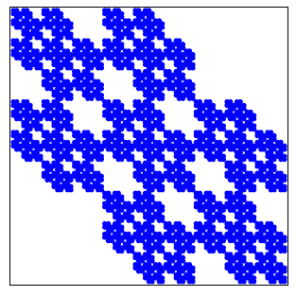




MLE for Graphs
P(
|
)
AGM
arg max

Slide 43
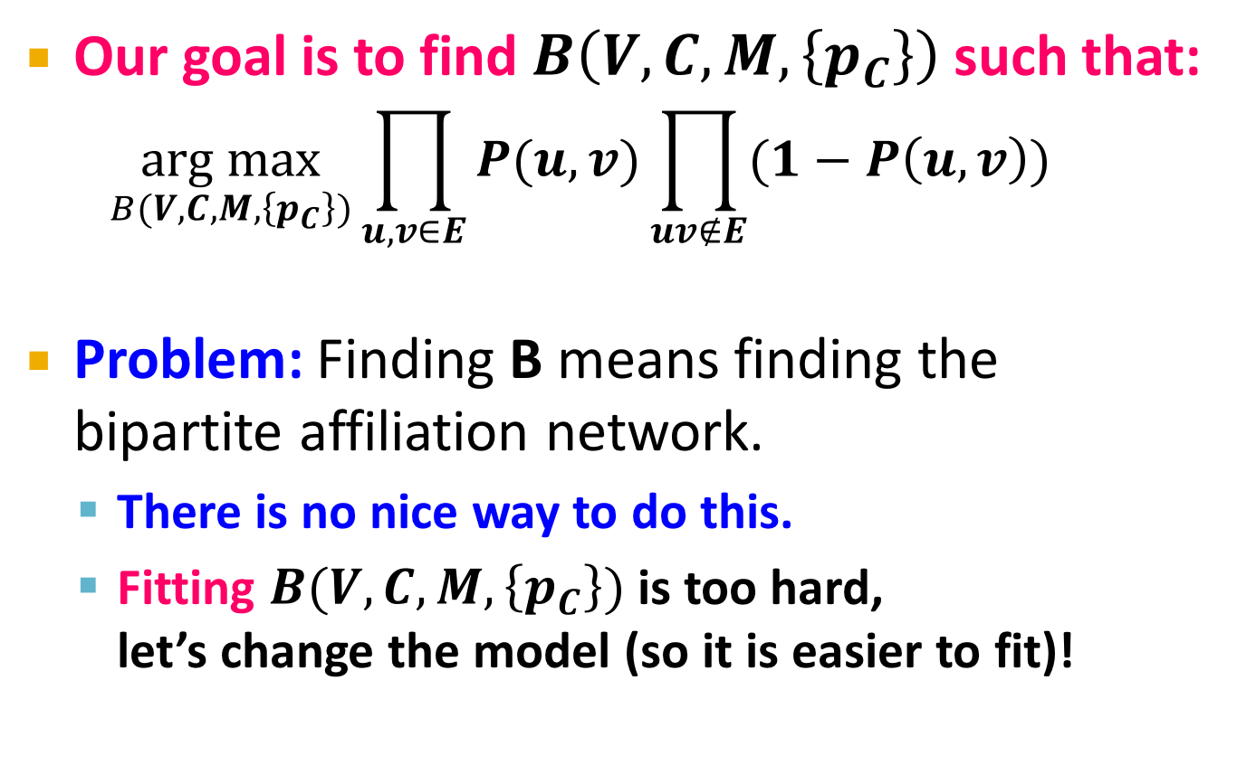
MLE for AGM

Slide 44
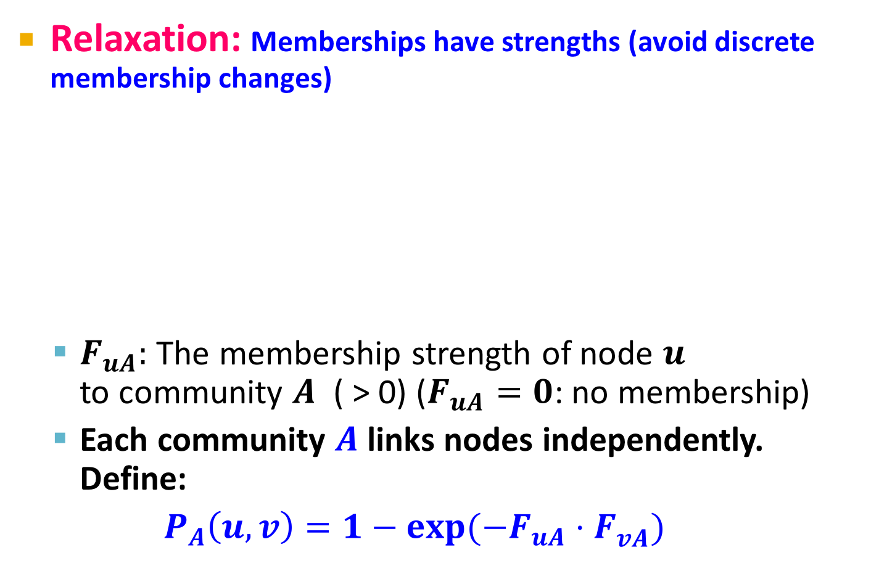
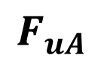
From AGM to BigCLAM (1)
Membership is not binary any more
u
v
Let us define

Slide 45
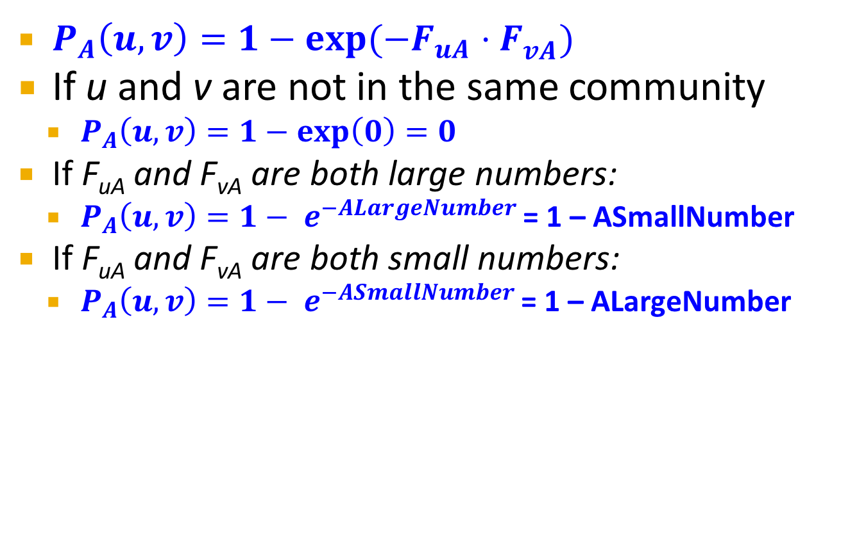
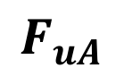
From AGM to BigCLAM (2)
u
v

Slide 46
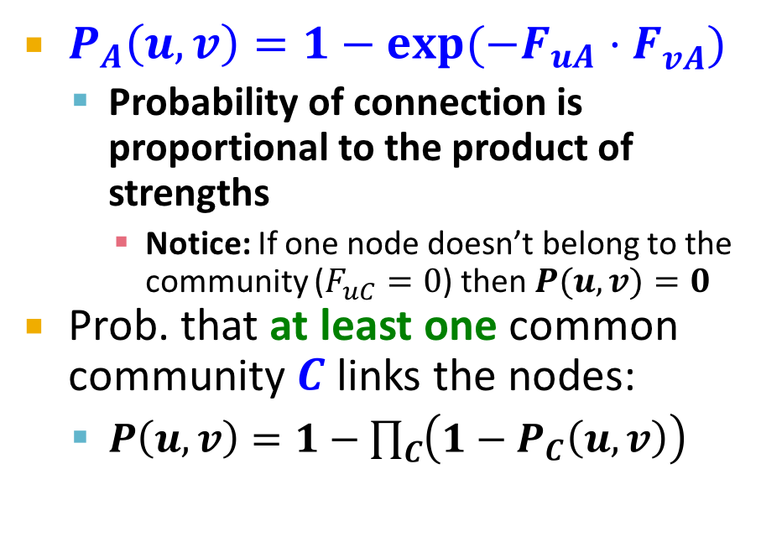



Community Membership Strength Matrix F
Communities
A
 | j
Nodes
i
u
v

Slide 47





From AGM to BigCLAM
0 | 1.2 | 0 | 0.2
// 0.2 x 0..8
0.5 | 0 | 0 | 0.8
// 1-exp(-(1.2*1.8))
0 | 1.8 | 1 | 0
Node community membership strengths

Slide 48


BigCLAM: How to find F
Notes:
Maximizing a function also maximizes the logarithm of that function
Summing small numbers has less errors than mutiplying them
There were questions today on how to estimate the F matrix in BigCLAM and how to estimate the number of communities in general. First, to estimate the number of communities, one method is to take samples of the graph and iteratively fit your model with a different community number to check which of them has the largest maximum likelihood. Alternatively, in practice, many times you will know the number of communities beforehand and the goal is to identify the community memberships. To estimate the F matrix in BigCLAM, again, you need to first have a heuristic on the number of communities (i.e., the number of columns in your F matrix). Then you can initialize the F matrix for every node by looking at the neighborhood connectivity of the node. Next, you iteratively (gradient accent) update the F matrix to find the F matrix that will generate the maximum likelihood. The process for that is on slides 40 and 41. Read this paper for more details: https://cs.stanford.edu/people/jure/pubs/bigclam-wsdm13.pdf

Slide 49




BigCLAM: V1.0
Notes:
Gradient descent is a first-order optimization algorithm. To find a local minimum of a function using gradient descent, one takes steps proportional to the negative of the gradient (or of the approximate gradient) of the function at the current point. If instead one takes steps proportional to the positive of the gradient, one approaches a local maximum of that function; the procedure is then known as gradient ascent.

Slide 50


BigCLAM: V2.0
(By examining the F matrix)

Slide 51

BigClam: Scalability
BigCLAM takes 5 minutes for 300k node nets
Other methods take 10 days
Can process networks with 100M edges!

Slide 52


Summary of BigCLAM
Given G(V, E), compute B(C,M,{p_{c}}) such that P(G|B) is maximum
But it is too hard to find C, M, and {p_{c}} this way
V1.0. Change to a model easier to find
Replace C and M by F // binary —> strength
Define P(u,v) = 1-exp(-F_{uA}F_{vA})
Compute F such that P(G|F) is maximum
V2.0. Speed up the computation of
By computing

Slide 53
EXTENSION: DIRECTED MEMBERSHIPS

Slide 54

Extension: Beyond Clusters

Slide 55


Extension: Directed AGM
Extension: Make community membership edges directed!
Outgoing membership: Nodes “sends” edges
Incoming membership: Node “receives” edges

Slide 56

Example: Model and Network

Slide 57





Directed AGM
// two membership matrixes

Slide 58







Predator-prey Communities

Slide 59
More Details at…
Overlapping Community Detection at Scale: A Nonnegative Matrix Factorization Approach by J. Yang, J. Leskovec. ACM International Conference on Web Search and Data Mining (WSDM), 2013.
Detecting Cohesive and 2-mode Communities in Directed and Undirected Networks by J. Yang, J. McAuley, J. Leskovec. ACM International Conference on Web Search and Data Mining (WSDM), 2014.
Community Detection in Networks with Node Attributes by J. Yang, J. McAuley, J. Leskovec. IEEE International Conference On Data Mining (ICDM), 2013.

